Slide 1

WHO SMART Guidelines L3 adaptation tutorial

Slide 2

Africa CDC HIE Framework
For exchanging data for digital health and cloud communications, use IHE or HL7® Fast Healthcare Interoperability Resources (FHIR) standard cloud communications. FHIR combines the best features of HL7v2, HL7 V3R2 CDA and web standards (Extensible 28 Markup Language (XML), JavaScript Object Notation (JSON), HTTP, Atom and others). Because of this, the TF recommends all new implementations and digital health system improvements use FHIR as the primary mechanism for data exchange. The latest HL7 messaging standards can also be adapted
Excerpt from AU Health Information Exchange Policy and Standards for Electronic Disease Surveillance, section 4.3 Messaging Standards
Notes:
Perhaps put Africa CDC FHIR IG as deliverable for this year as part of section c/annex to the HIE Framework

Slide 3

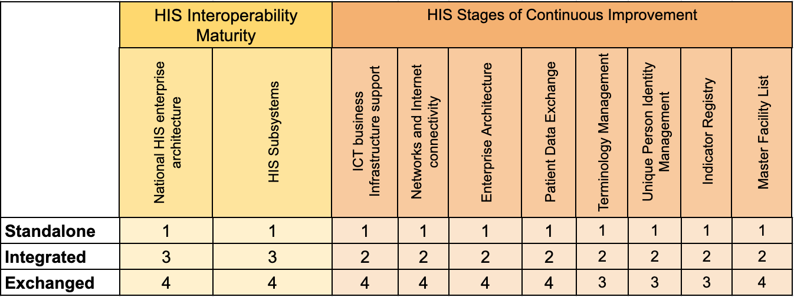
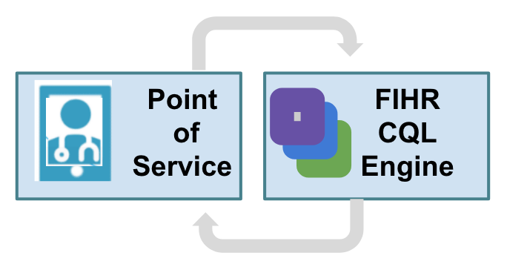
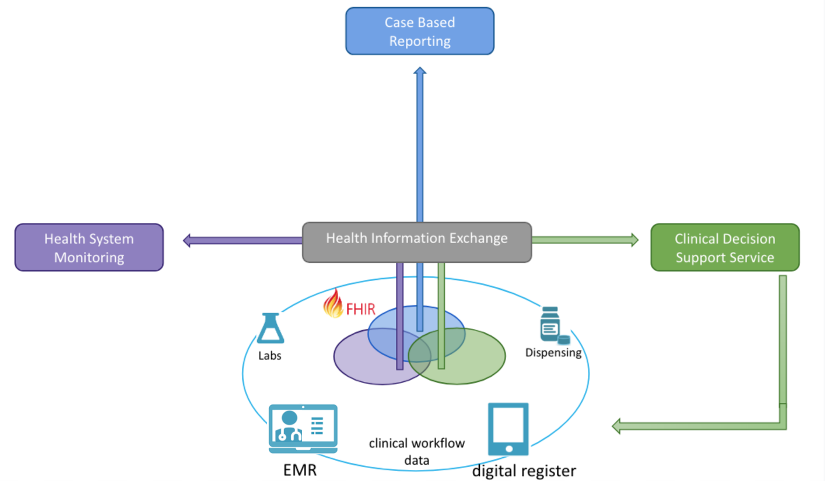
Staged Maturity Model Scenarios
Mapped against Health Information Systems Interoperability Maturity Toolkit (Measure/Evaluation)

Slide 4
Support for Points of Service / Data Sources at Different FHIR Capability Levels of Data Normalization
Data Source: FHIR Naive
Data Source: FHIR Aware
Data Source: FHIR Native
Existing tool with limited resources/desire to upgrade to include FHIR support.
Have back-end access to database or existing way to generate tabular reports.
Can export data in a limited number of FHIR resources (e.g. Questionnaires) from templated reports.
Can initiate FHIR API calls for metadata synchronization using IHE profiles (SVCM, mCSD). May use a façade model
Full FHIR stack, data model and supporting tools are within the system. Can generate robust FHIR resources and data models and
Metadata synchronization using IHE profile (SVCM, mCSD)

Slide 5
Improving Data Generation to Data Use
FHIR Naive Data Sources
Data Normalization
FHIR Data Store/ Warehouse
Analytics Data Visualization
Multiple paper and electronic systems can serve as a data source for a case report from a point of service system. Each system uses their own data models, patient identifiers and terminologies/codings which makes automated synthesis of data difficult.
To make the comparison and synthesis of data from the various data sources, we need to normalize the data. To normalize data, we agree on a standard data model (e.g. HL7 FHIR) and codings (e.g. ICD) and map/transform data received from the data sources to meet the standard model.
Once data has been normalized, we can store the data from the various sources in a single database with a well defined schema according to our data model.
We want a data store which makes it easy to store the individual and aggregate, provides good indexing for fast searching, and allows us to easily de-identify patient records.
Once data has been stored, we use data (e.g. de-identified case reports) to produce visualizations.
Many types of visualizations, alerts, and data analysis may be desired so we need to ensure flexibility in the choices of data visualization tools and, to the extent possible, allow people to use their prefered tools.

Slide 6

Example: Case Reporting Data Submission
Document case report data needs in Logical Model and map into FHIR Document using Structure Map
FHIR Naive:
Legacy data schemas/tabular data documented in data dictionary and as FHIR Logical Model.
CSV/Excel export data represented as Logical Model instances.
Use Structure Maps to transform into case report Logical Model
FHIR Aware:
Case Report Questionnaires transformed into Case Report Documents using Structured Data Capture (SDC) with Structure Maps
Case Report Submitter: FHIR Naive
CSV export/ tabular data
Legacy Logical Model
Case Report Submitter: FHIR Aware
Case Report Logical Model
Questionnaire Response
case report Document
case report Composition
Provenance (source data)
Case Report Submitter: FHIR Native
case report Document
Case Report Repository

Slide 7
Typical data and computational needs for edge computing of computable care three network tiers in LMICs
Infrastructure: Increasingly reliable connectivity though may be low-bandwidth. Increasing needs to synchronize data with regional and global cloud services. Peer-to-peer data exchange within tier. Power cuts infrequent but may have extended duration.
Data Flows: Needs to update metadata, libraries of executable code for computable care indicators and decision support services from cloud services. Aggregate reports are sent up to regional and global health agencies (e.g. WHO) running in the cloud.. Clinical information from health facilities are pulled up into referal hospitals and labs.
Code Execution: Runs report on clinical information Executes data curation services such as de-identidfication or anonymization of records, automatic record linkage, record merging.
Tiers
Mostly
Online
Intermittent
Mostly
Offline
national lab
MOH & reporting agencies
referral hospital
district health office
Infrastructure: Intermittent low-bandwidth connectivity. LAN within health facility, but very limited peer-to-peer data exchange within tier (to other health facilities). SMS available. Power not consistently reliable. Using tablet or PC, possibly shared across users..
Data Flows: Needs to pull down updates to metadata, libraries of executable code for computable care indicators and decision support services from cloud services. Needs to pull up all clinical information from CHWs. Needs to pull down clinical information form referral hospitals, labs for clients which are expected to be seen (based on facility catchment areas, referrals or family relationships) . Aggregate reports, calculated both locally and relayed from CHWs, are sent to reporting agencies and district health offices on a routine basis. Clinical information collected locally pushed up when connected. Sends aggregate reports a routine basis to district health offices and national reporting agencies.
Code Execution: Needs to task CHWs for the coming week based on data collected locally and pulled from other sources. Needs to run aggregate reports on a routine basis on data both collected locally and pulled up from CHWs. Executes data curation services such as automatic record linkage, record merging. May run decision support services for both health facility users as well as to push out messages/tasks to CHWs.
health facility
Infrastructure: Weekly access to low-bandwidth connection when CHW visits facility. SMS usually available. No peer-to-peer data exchange within tier. Solar based power sources. Using feature phone, smartphone or tablet.
Data Flows: Needs to update metadata, libraries of executable code for computable care indicators and light-weight decision support services. Pulls down from health facility or health facility clinical information about expected clients for the next week. If bandwidth allows then it needs to send clinical data collected over the week to the health facility Sends aggregate reports on a routine basis.
Code Execution: Needs to execute decision support services locally on clinical information, on data both collected locally and pulled down. Needs to run aggregate reports on a routine basis on data collected locally..
community
health worker (CHW)

Slide 8
Orientation to Implementation Guide artefacts

Slide 9
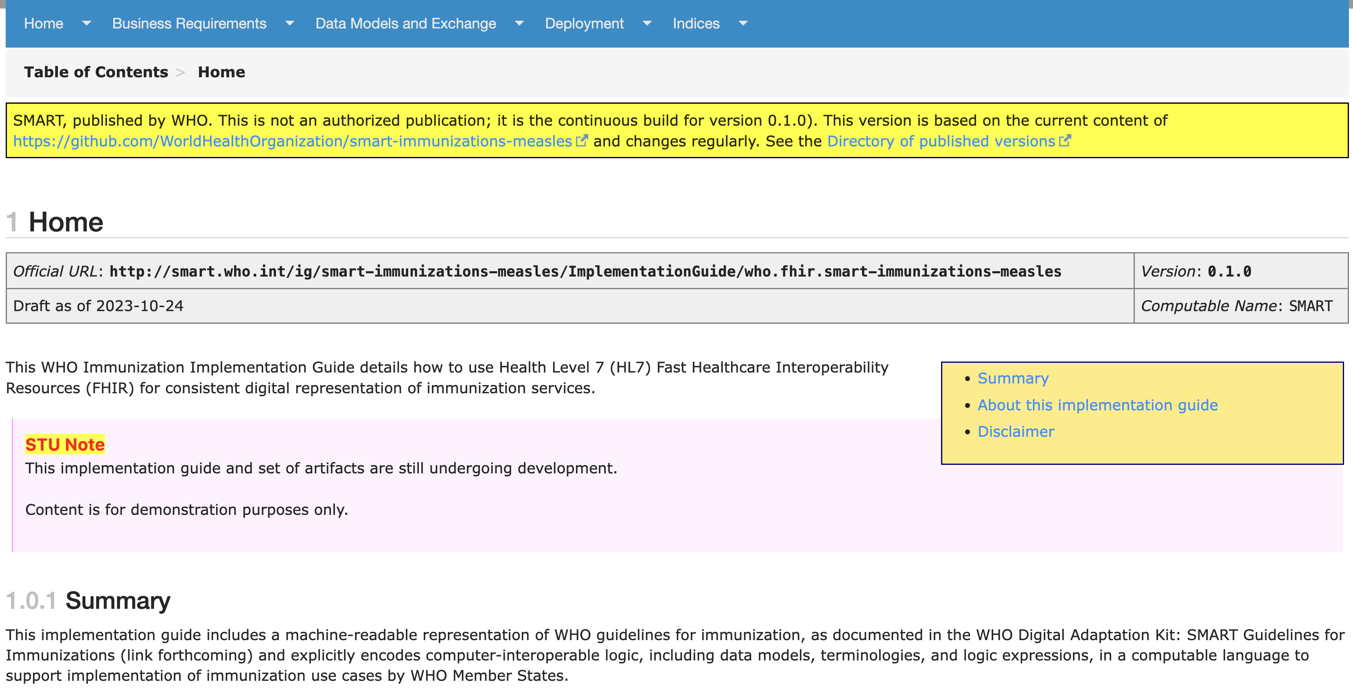

SMART Measles Implementation Guide https://worldhealthorganization.github.io/smart-example-immz

Slide 10
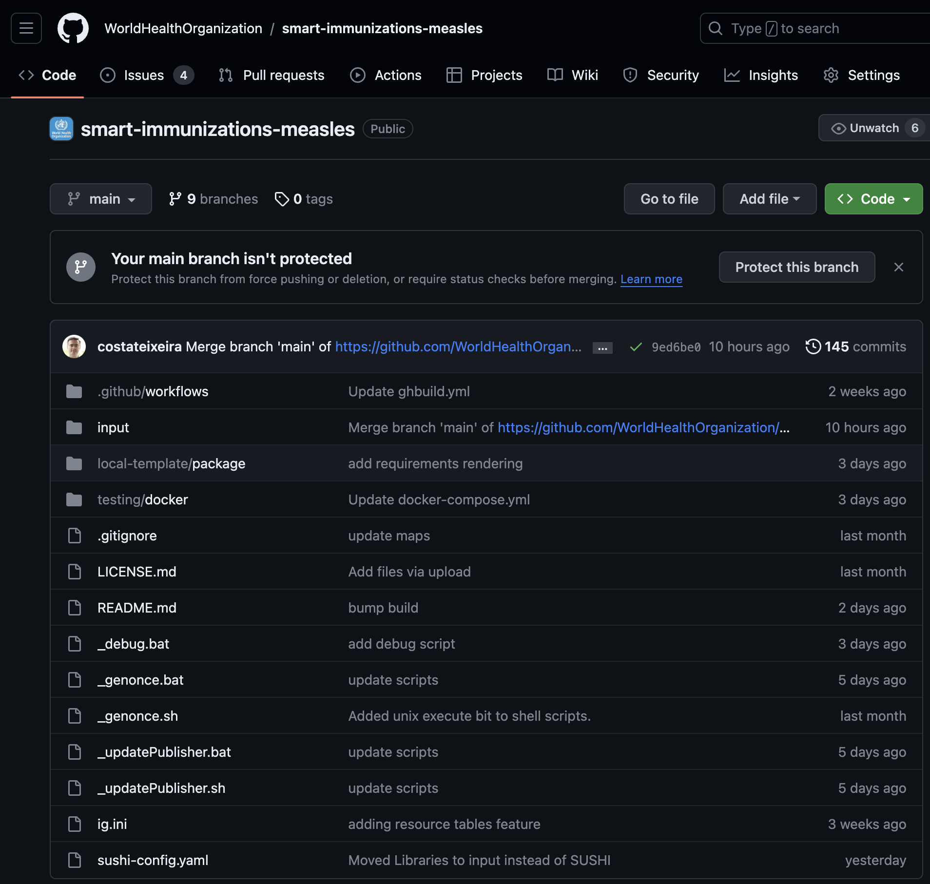
SMART Measles Implementation Guide – Source Code https://github.com/WorldHealthOrganization/smart-example-immz
IG publisher

Slide 11
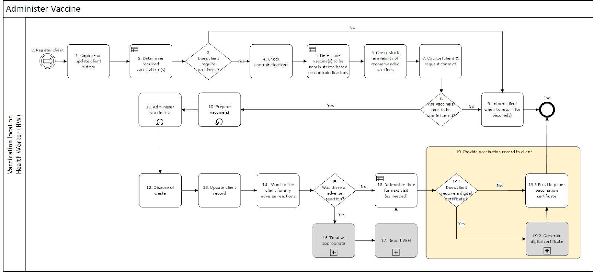
Clinical Workflow

Slide 12
Clinical Workflow
What data do we want to capture? Logical Model
What is the user interface for capturing data? Questionnaire

Slide 13
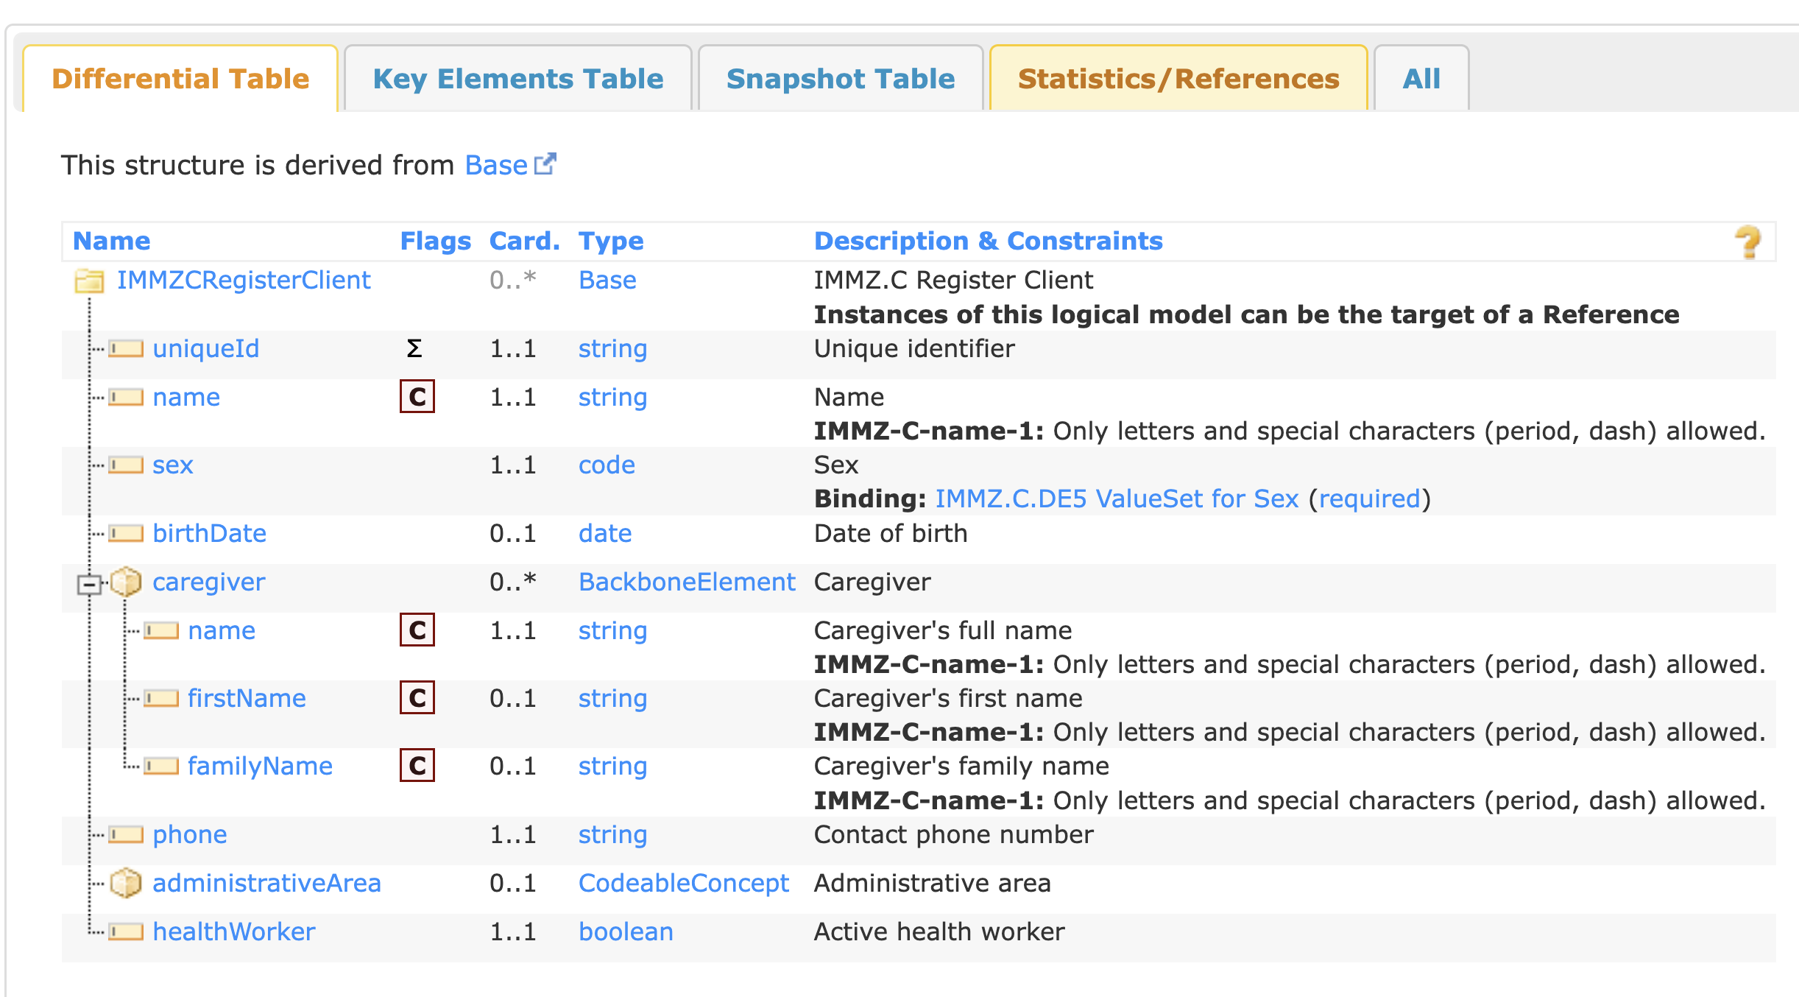
1. Capture or Update Client History
What data do we want to capture? Logical Model

Slide 14
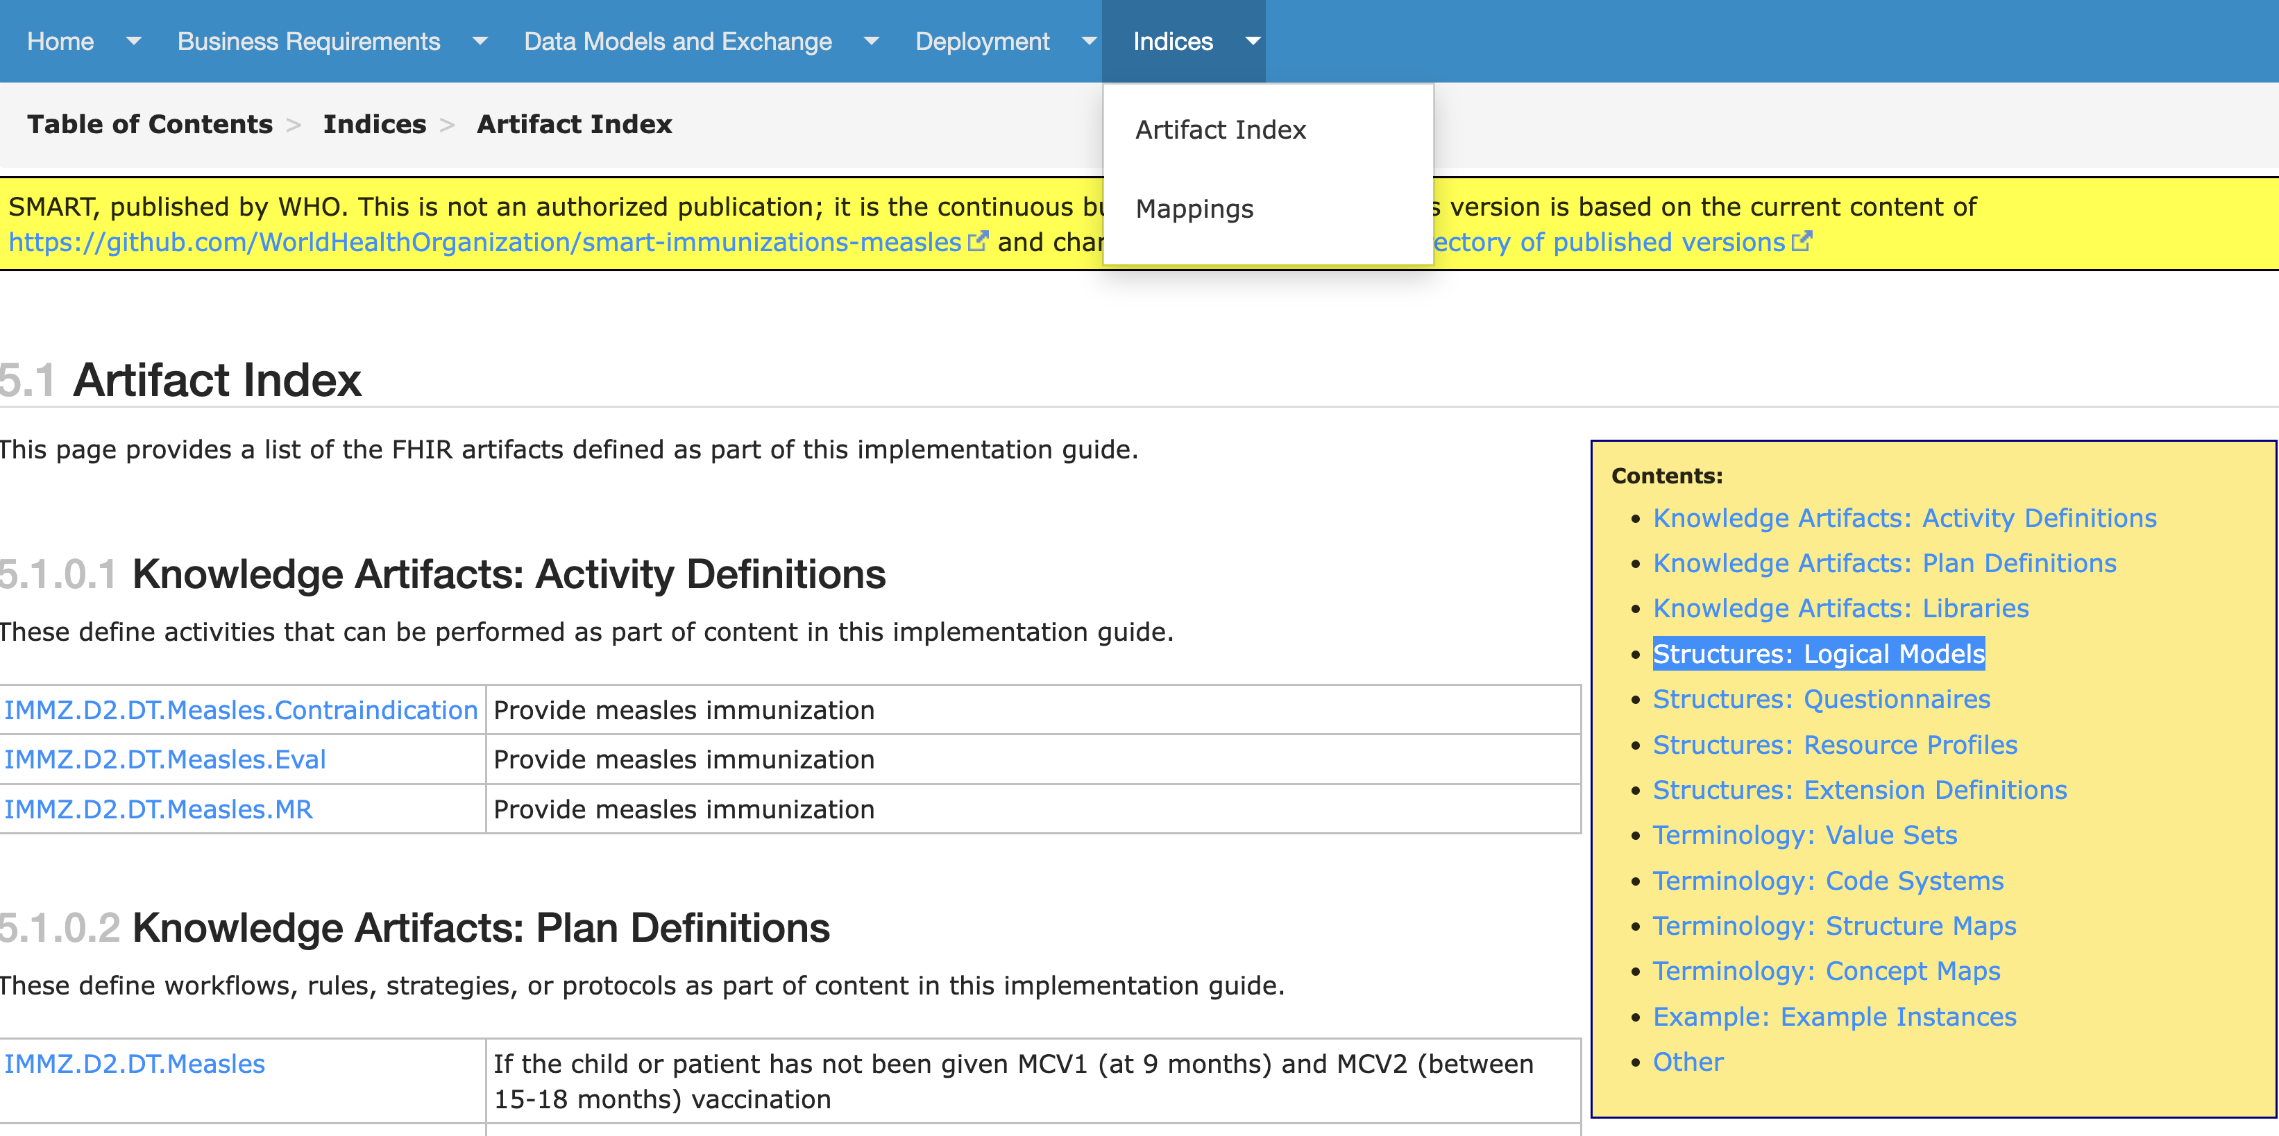
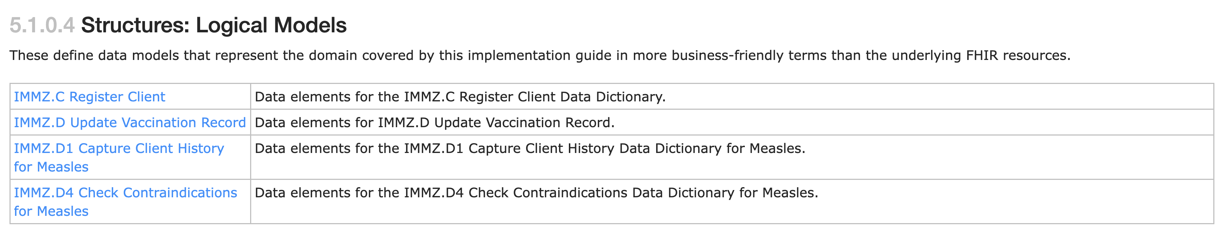
Implementation Guide: Artifact Index

Slide 15
1. Capture or Update Client History: ValueSet for Sex
What data do we want to capture? Logical Model

Slide 16
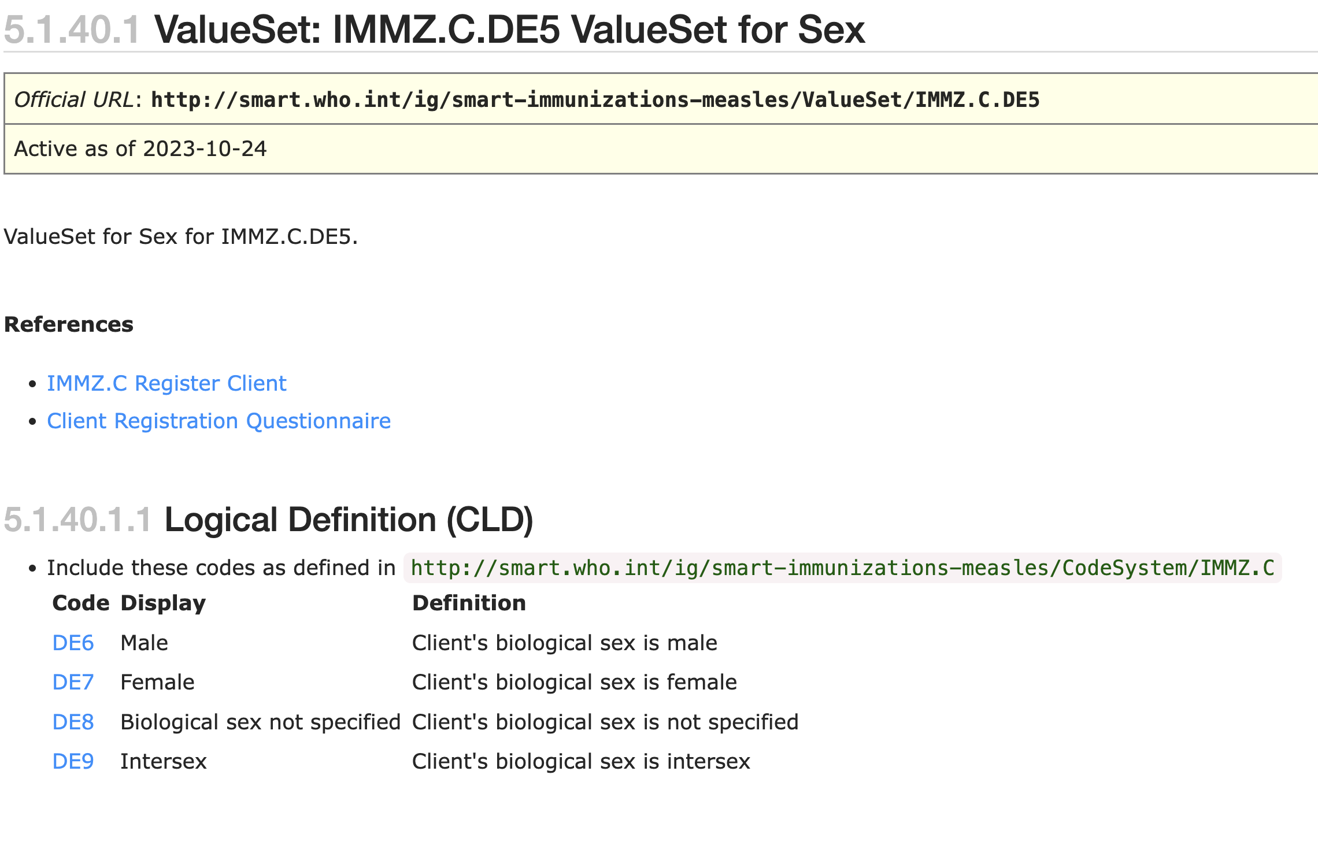
1. Capture or Update Client History: ValueSet for Sex
What data do we want to capture? Logical Model

Slide 17
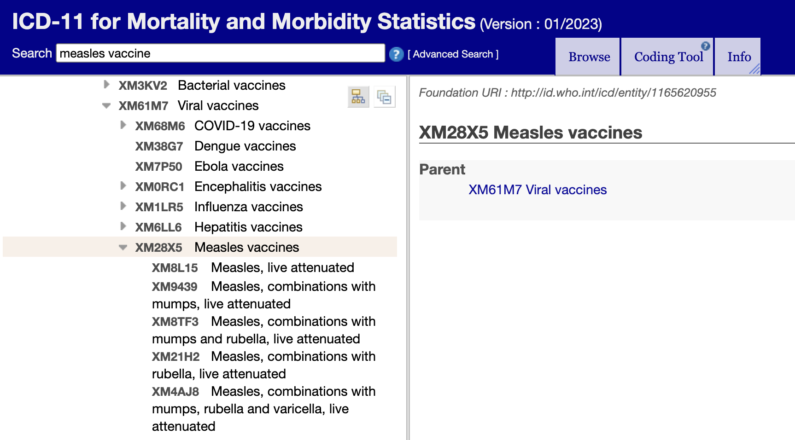
1. Code Systems and Value Sets for Sex
Code System: A collection of related concepts (codes with labels and definitions). Can be pre-existing sets such as ICD-10, ICD-11, LOINC, or ICHI. Can also be a set defined by a country or for use within an implementation guide.
Value Sets: A selection of codes across one or more code systems for a specific use (e.g. populating a drop-down list).
Concept Map: A mapping between the codes between two code systems. Useful for mapping across code-systems such as a list of country vaccine codes to the ICD-11 codes.
https://icd.who.int/browse11

Slide 18
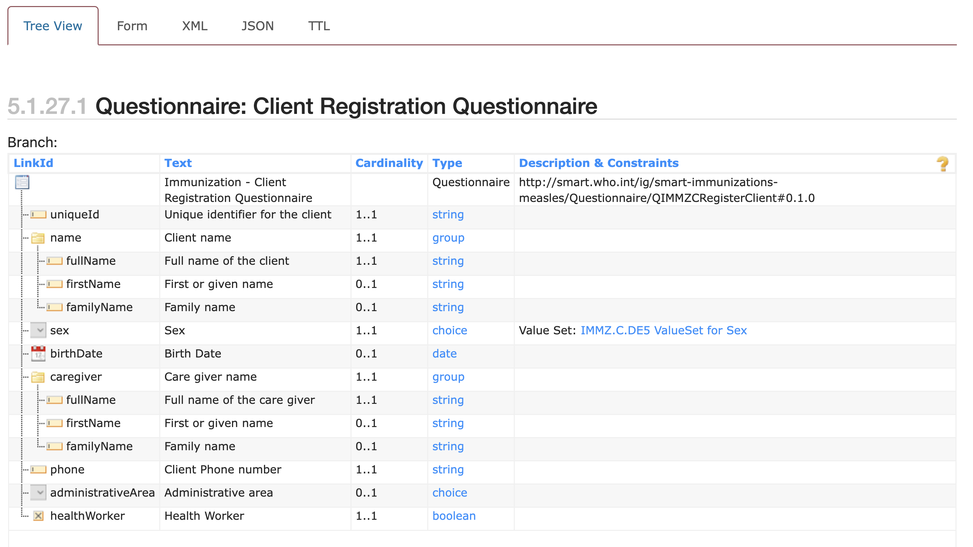
1. Capture or Update Client History
What is the user interface for capturing data? Questionnaire

Slide 19
1. Capture or Update Client History
What is the user interface for capturing data? Questionnaire

Slide 20
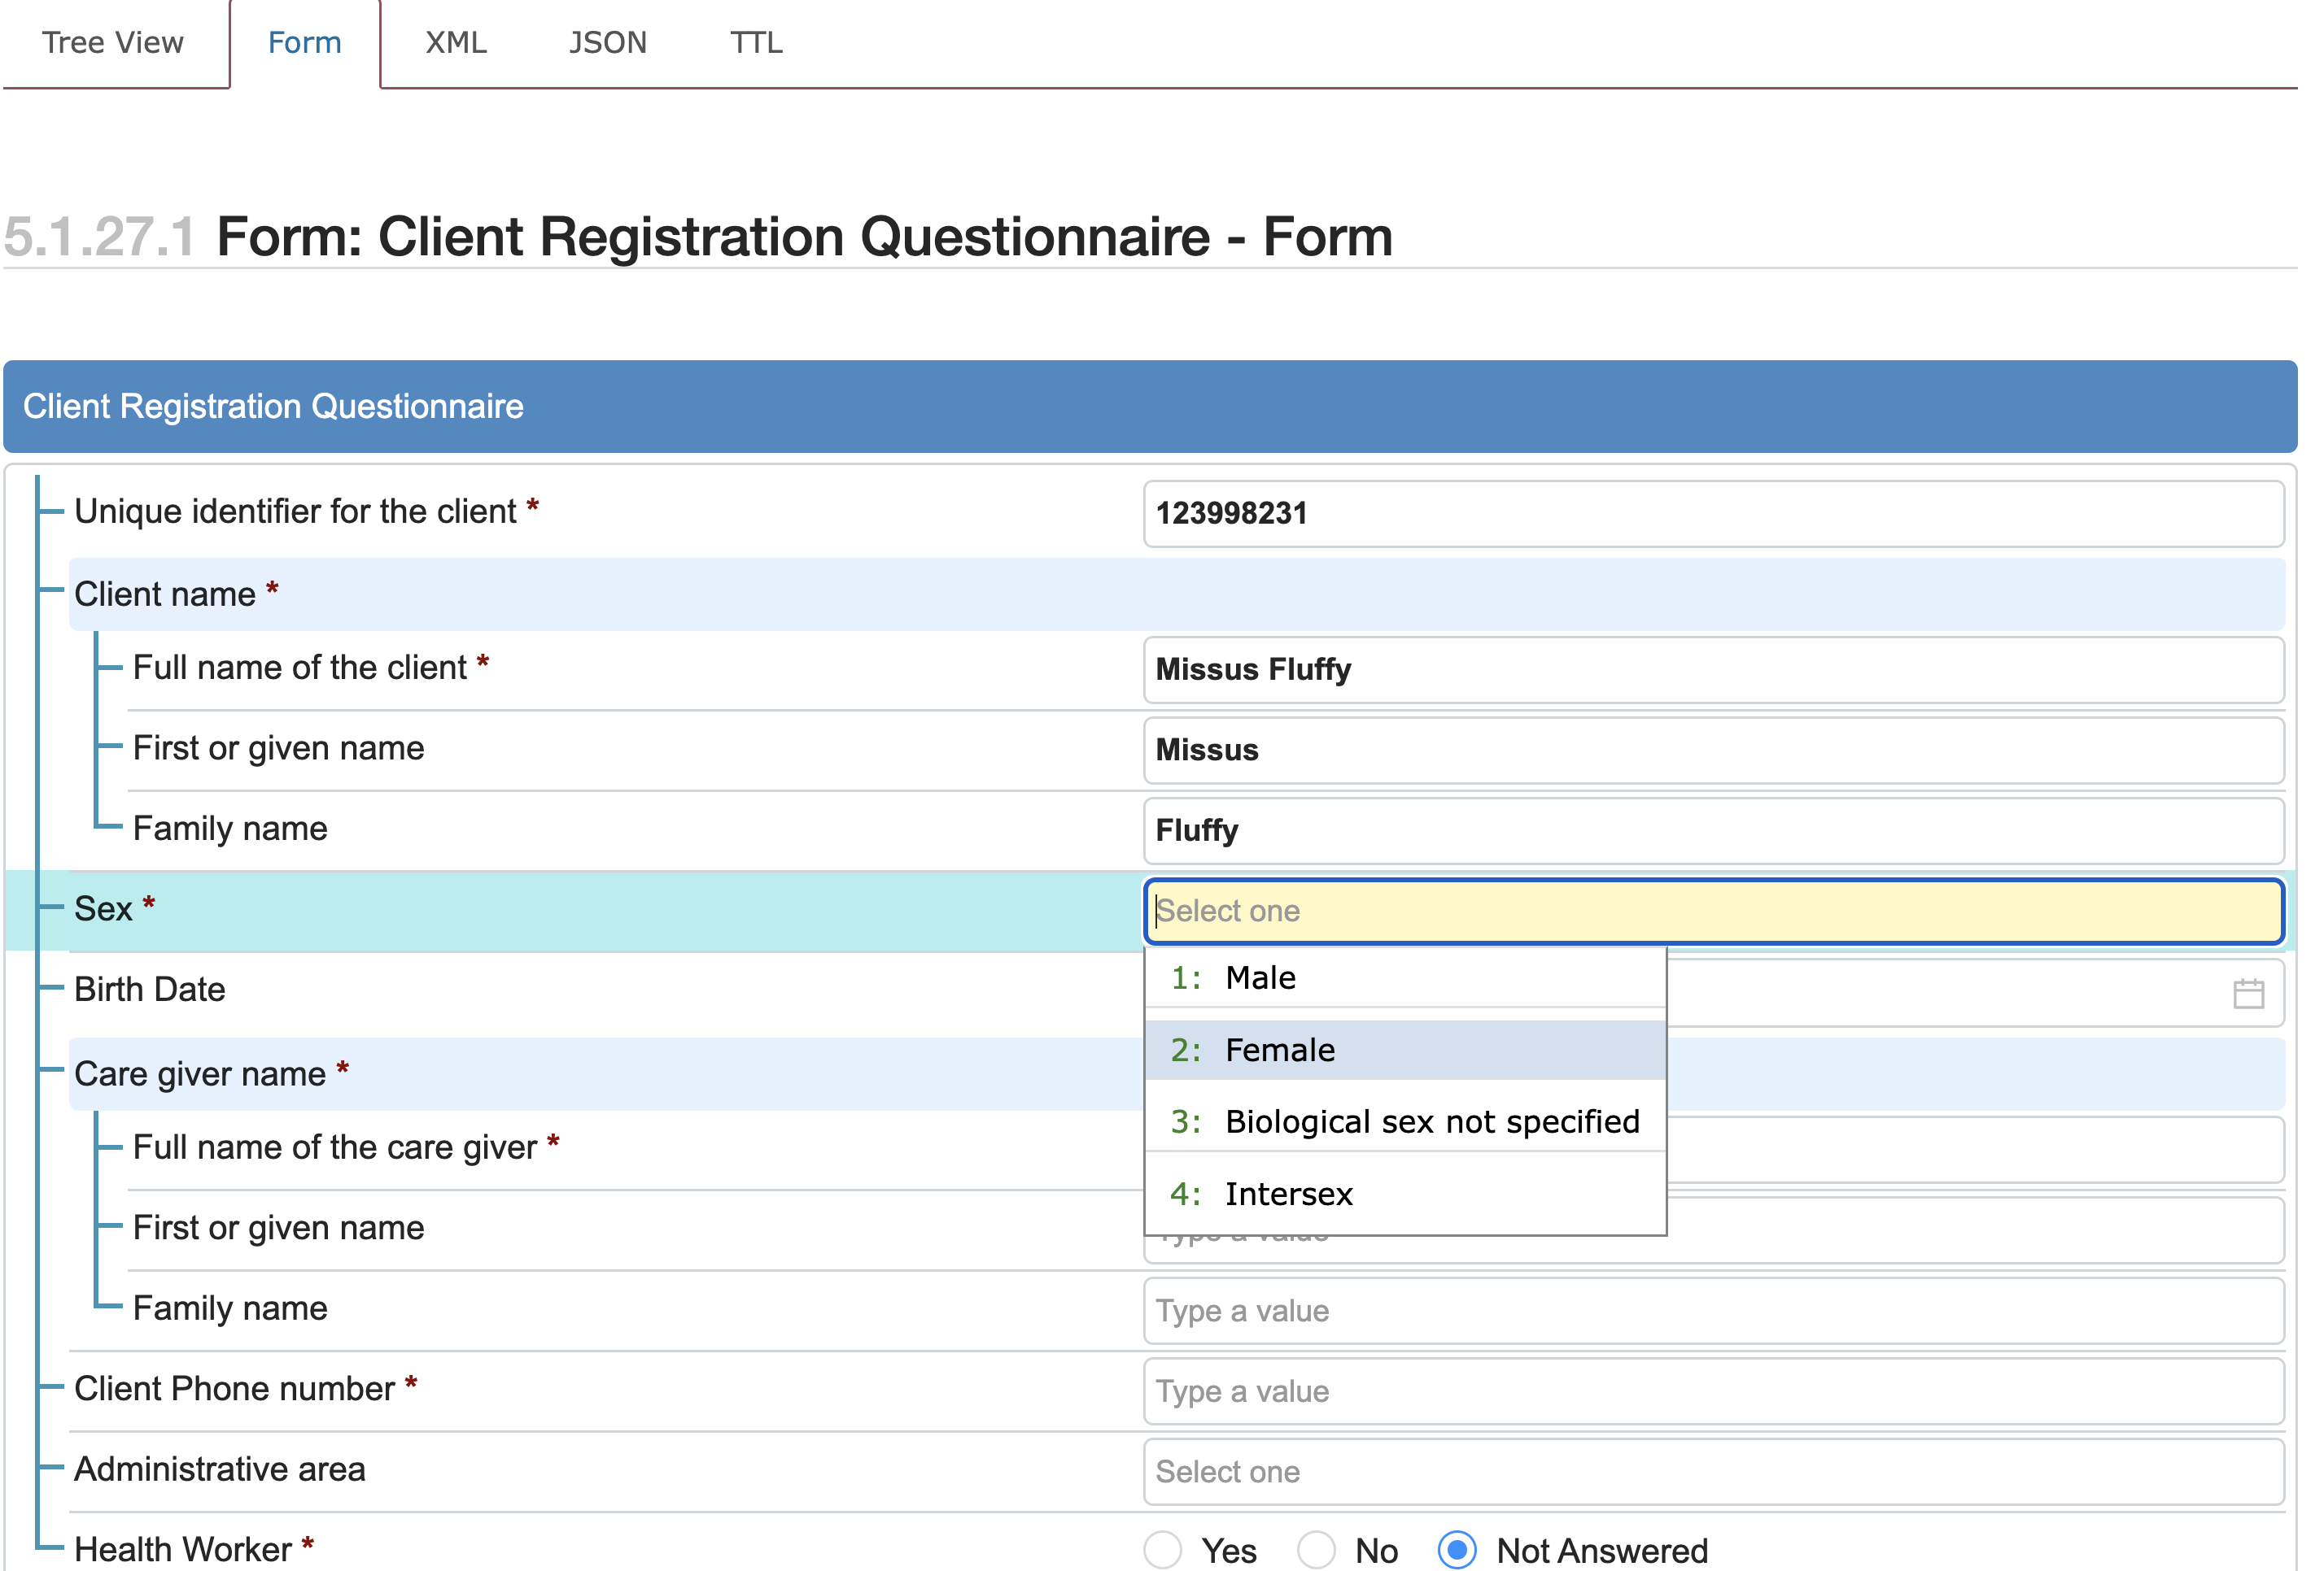
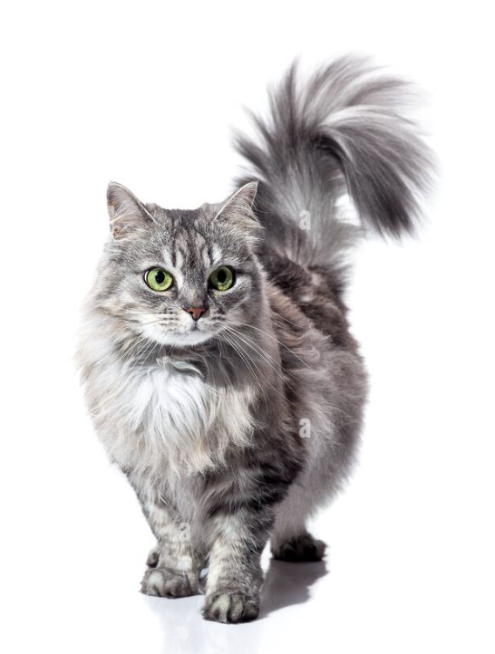
1. Capture or Update Client History
What is the user interface for capturing data? Questionnaire
Example resident of Catopia

Slide 21
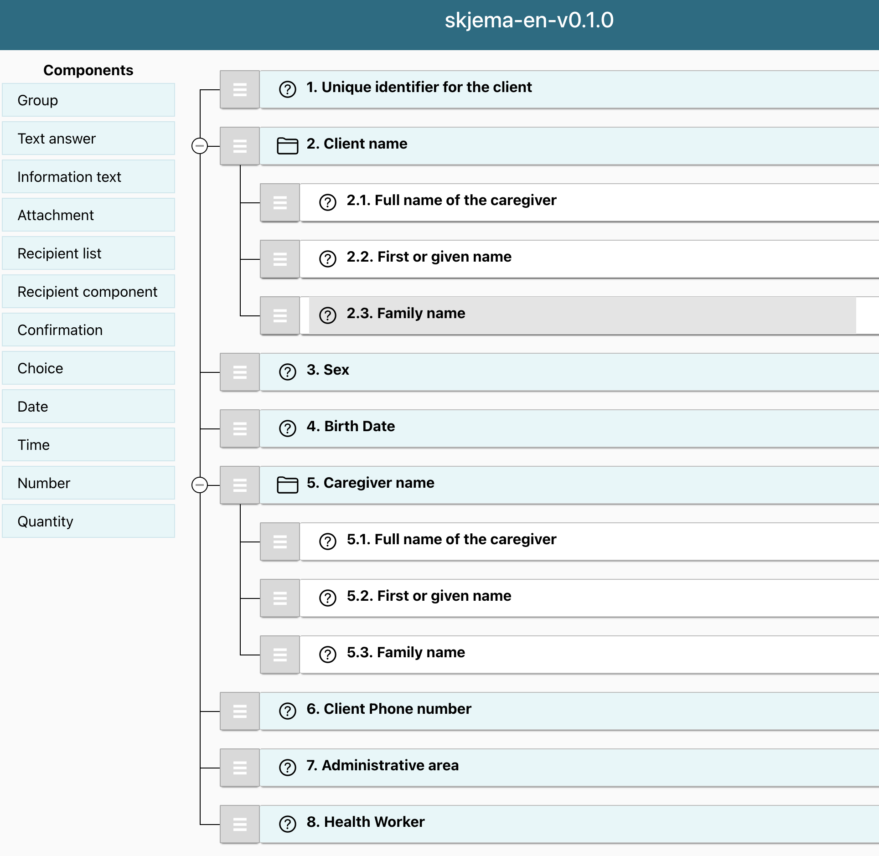

Form Builders
Several online tools to build questionnaires and forms:
https://static.helsenorge.no/static_skjemabygger/
https://formbuilder.nlm.nih.gov/
Exercise: Download existing Questionnaire and modify it:
https://worldhealthorganization.github.io/smart-example-immz/Questionnaire-QIMMZCRegisterClient.json.html
Click on “JSON” then “Download”

Slide 22
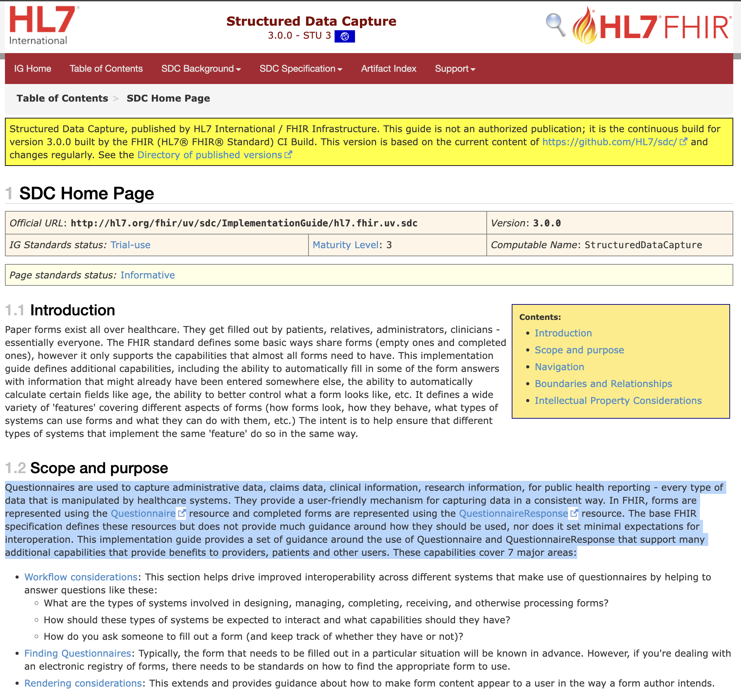


Slide 23
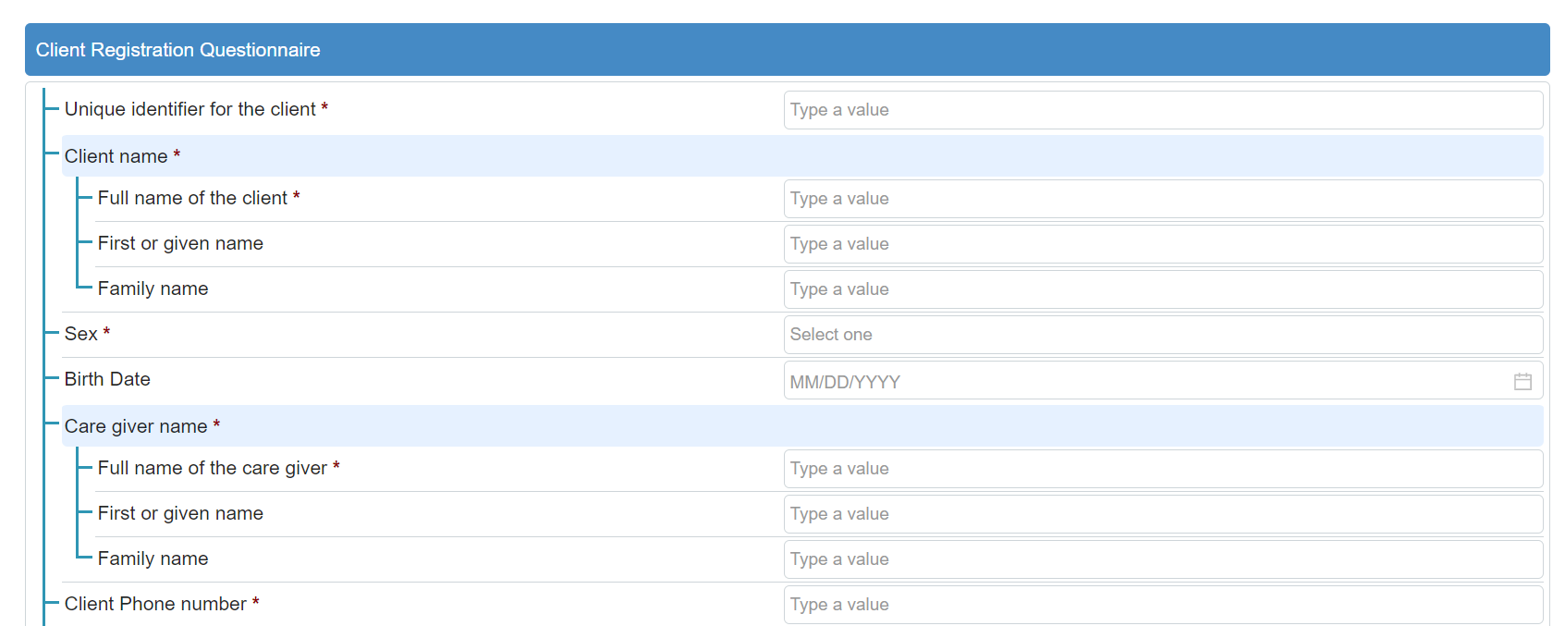
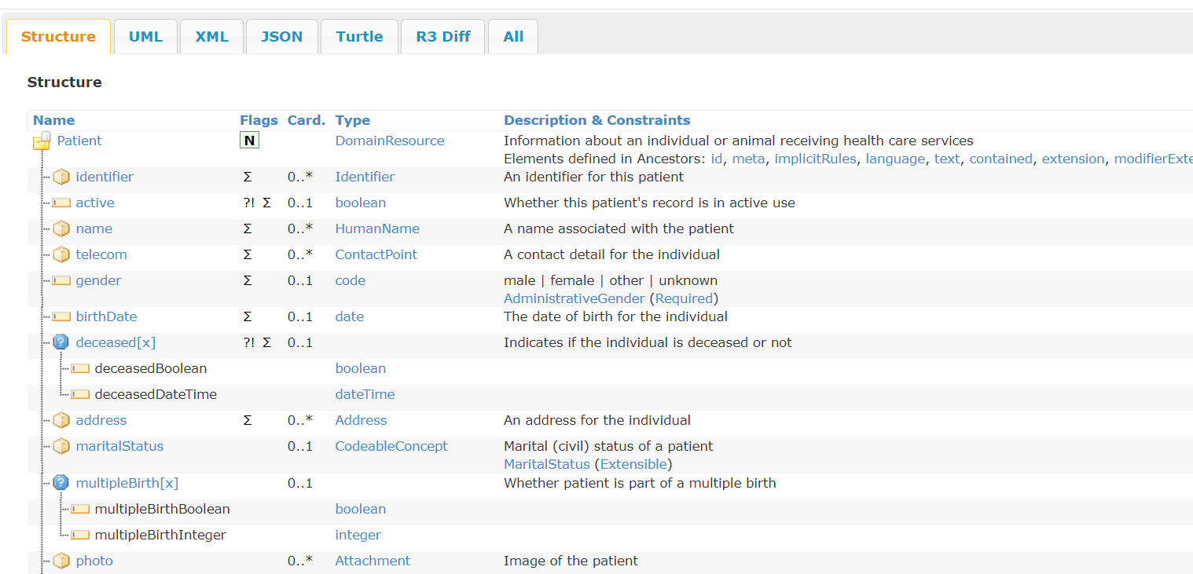
Going from Questionnaire to Resources
SOURCE
TARGET
Questionnaire Response
FHIR Resources

Slide 24

StructureMaps!
SOURCE
STRUCTURE MAPS
TARGET
Questionnaire Response
FHIR Resources

Slide 25
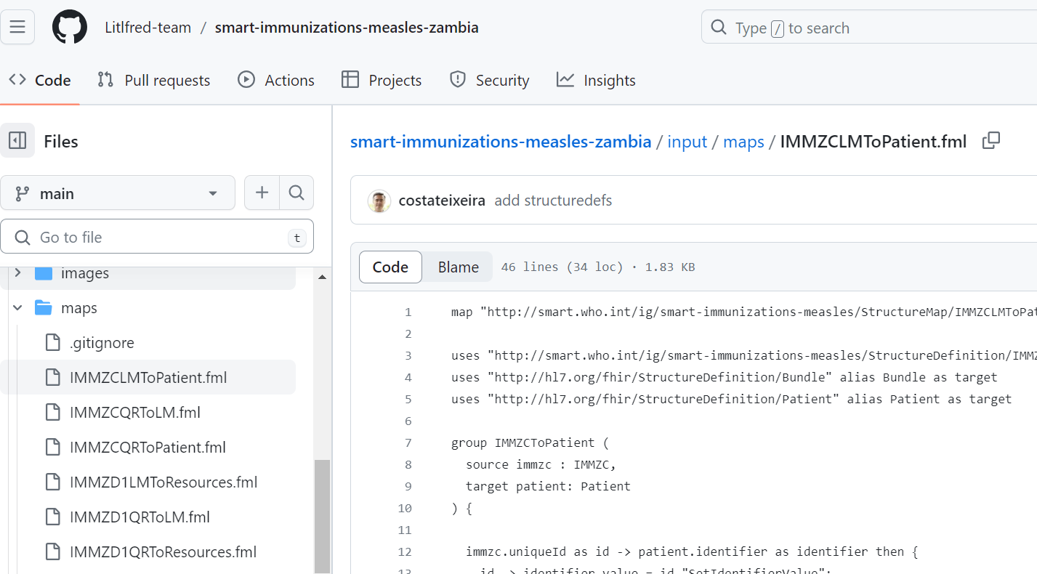
Introducing Structure Maps
Written using FML - FHIR Mapping Language
Found in the input/maps folder
Maps always go from a source to one or more targets
Best naming convention to use is in the format of “prefixSourceToTarget.fml”

Slide 26
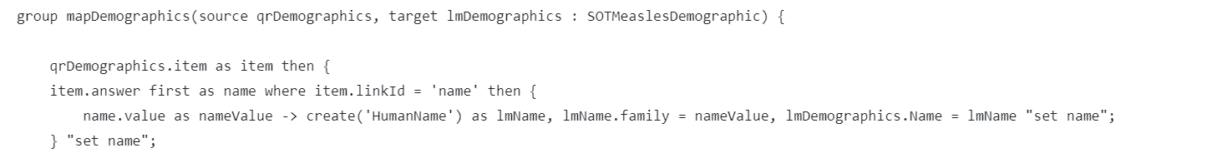
Structure Map Syntax
target is Logical Model - Demographics section
source is Questionnaire Response - Demographics section

Slide 27
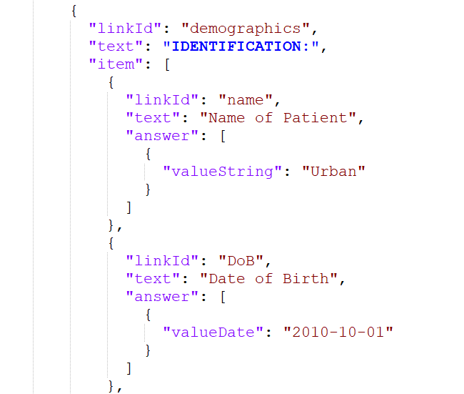
Understand Source Structure - Questionnaire Response

Slide 28
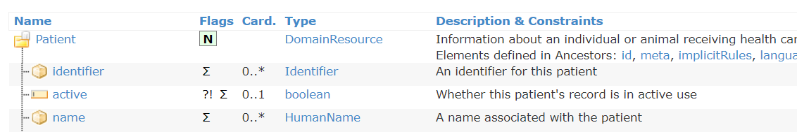
Understand Target Structure - Patient Name

Slide 29
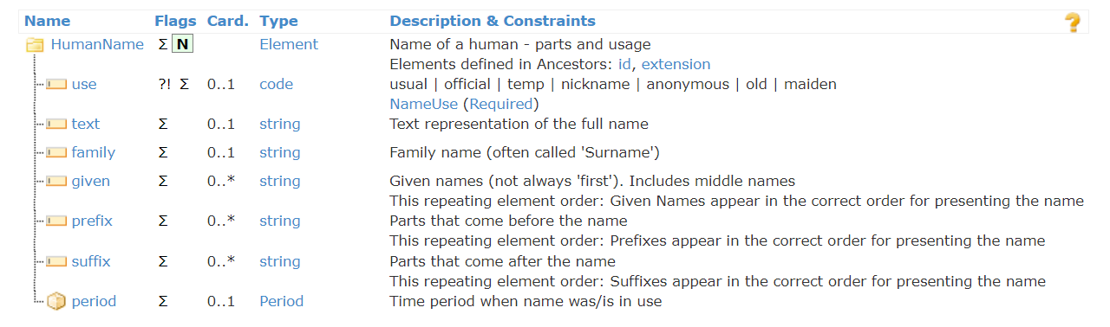
Understand Target Structure - Patient Name

Slide 30
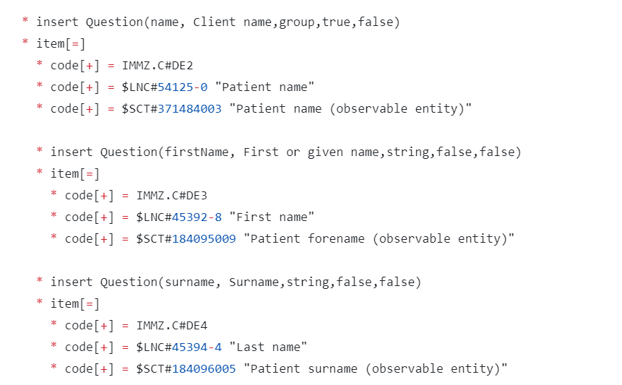
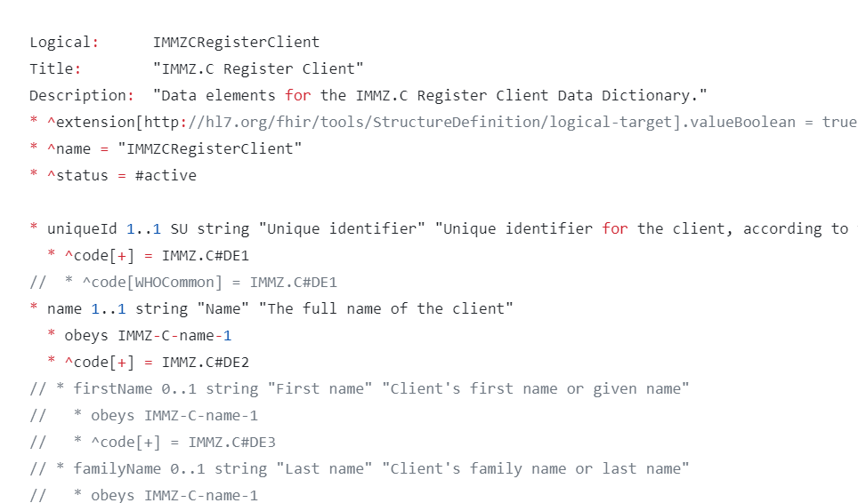
Let’s adapt
Logical Model
Questionnaire

Slide 31
Setting up your implementation guide https://smart.who.int/ig-starter-kit/

Slide 32
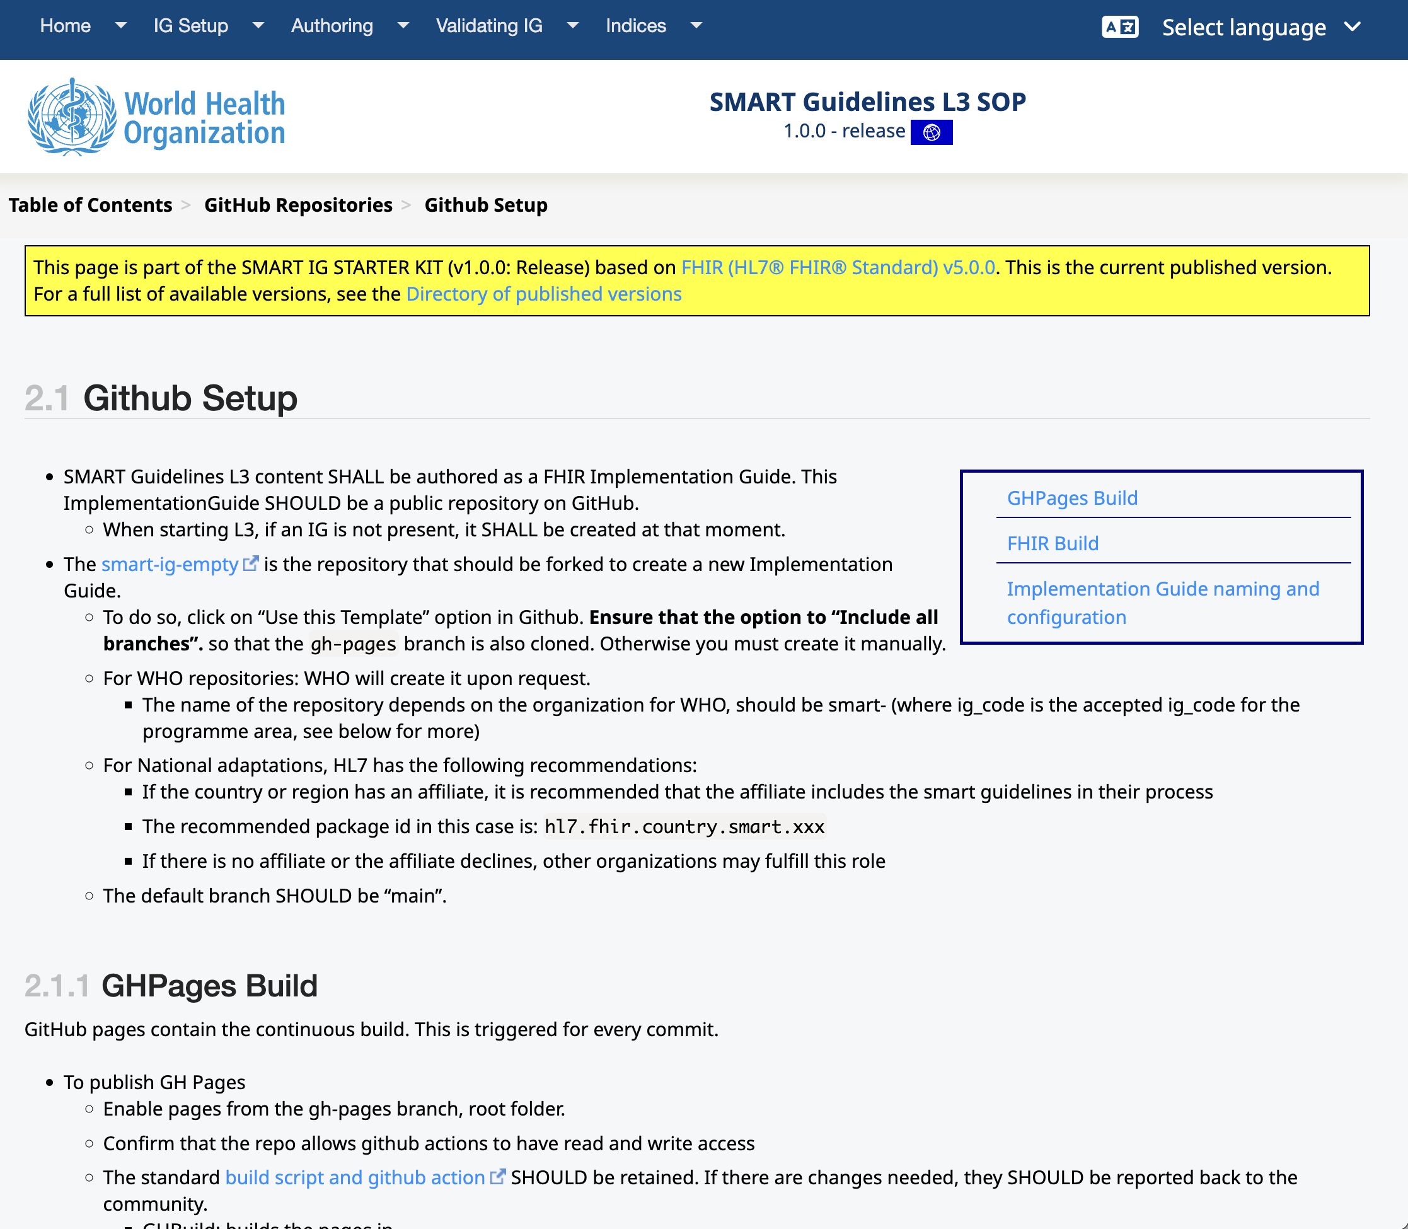


Slide 33
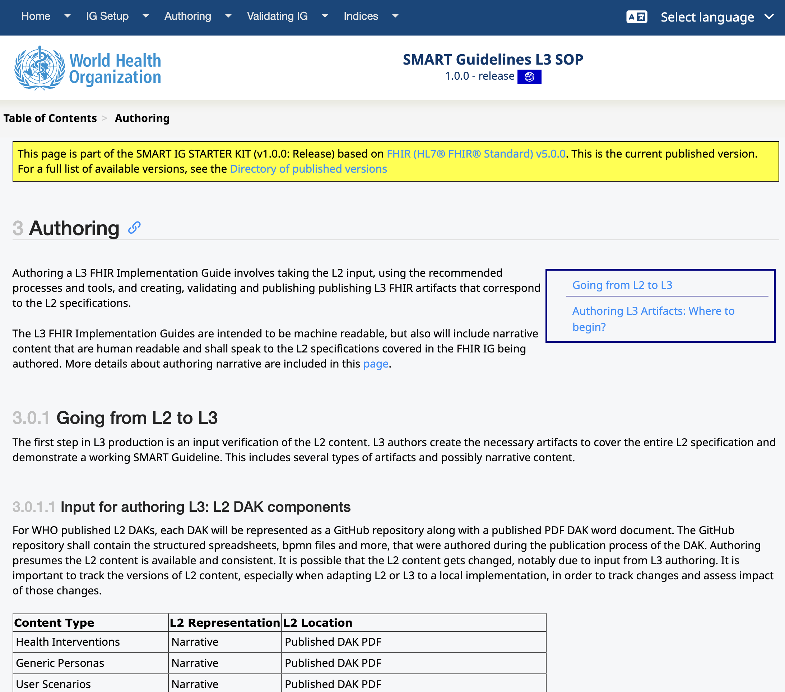

Slide 34
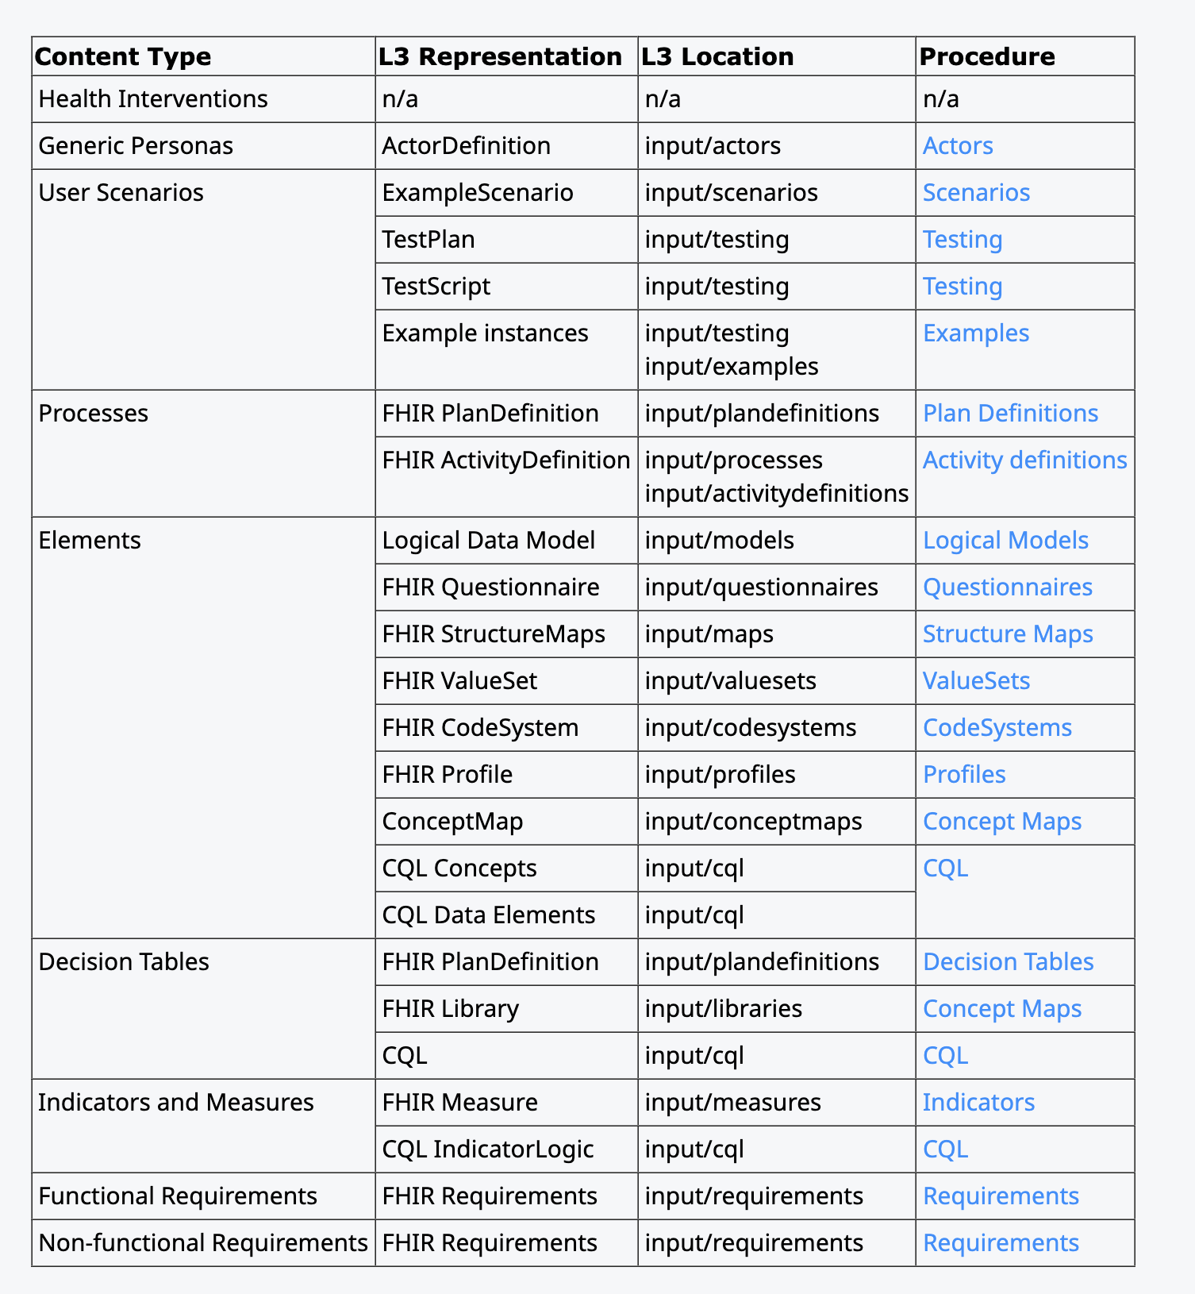

Authoring an L3 FHIR Implementation Guide
Authoring a L3 FHIR Implementation Guide involves taking the L2 input, using the recommended processes and tools, and creating, validating and publishing publishing L3 FHIR artifacts that correspond to the L2 specifications.

